Slide 1
Leave Application Management
Amol Modi
Anjana Pradeep
Supratika Banerjee

Slide 2
Introduction
The main objective of the proposed system is to decrease the paper work and easier record maintenance by having a particular website for attendance, leaves maintenance.
Initially leave application is given to the respective teacher in a paper form. Then the teacher checks the attendance and makes a call regarding granting the leave. Staff needs to submit the leaves manually to their respected higher authorities.
This increases the paper work at the same time maintaining the records is more tedious.

Slide 3
Existing System
In the current system, leave application is given to the respective teacher in a paper form. Then the teacher checks the attendance and makes a call regarding granting the leave. Staff needs to submit the leaves manually to their respected higher authorities. This increases the paper work and makes the record maintenance tedious. The attendance is updated regularly on the MIS-login.

Slide 4
Modules
Student
Teacher

Slide 5
Student Module
View Attendance Report
Apply for Leave
Check Leave form status

Slide 6
Teacher Module
Recording attendance
View Attendance Report
Granting/Rejecting Leave Application

Slide 7
HARDWARE REQUIREMENTS
SPECIFICATION :
Processor : Intel Family
Processor Speed : 250MHz to 667 MHz
RAM : 256 MB to 512 MB
Hard Disk : 40 GB
SOFTWARE REQUIREMENTS
SPECIFICATION :
Front End : HTML5/HTML
Middle ware : PHP
Back End : SQL
Operating System : 64 bit Architecture

Slide 8
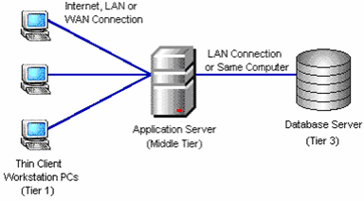
The structure of the software is as follows:

Slide 9
The following are some of the
screen shots:

Slide 10
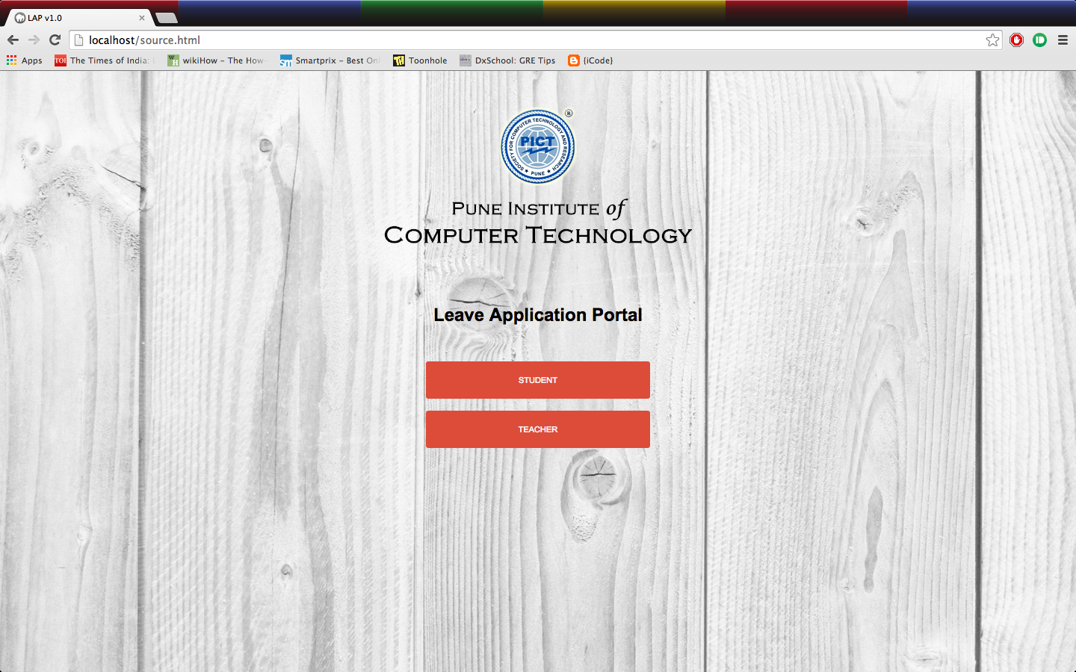
Main Page

Slide 11
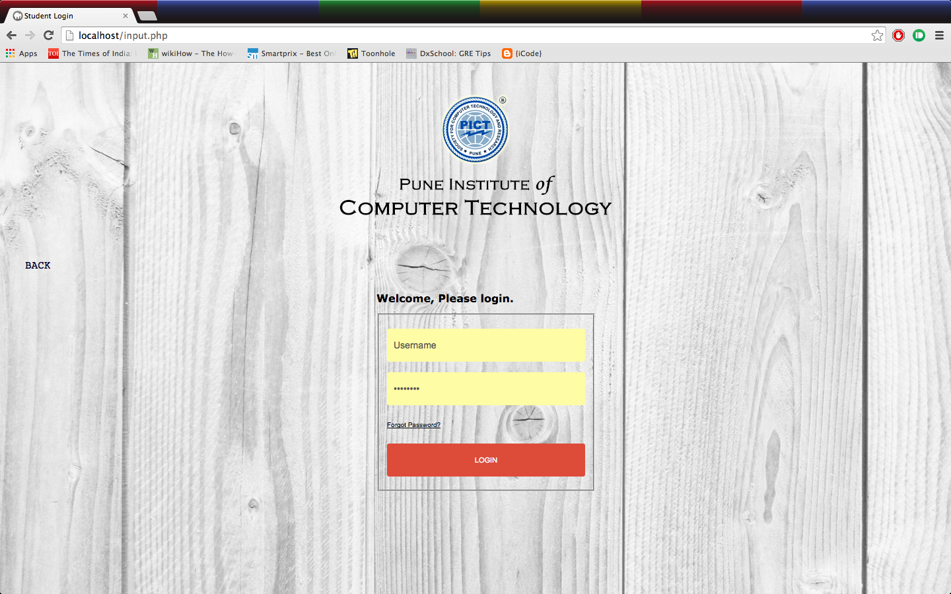
Login Page

Slide 12
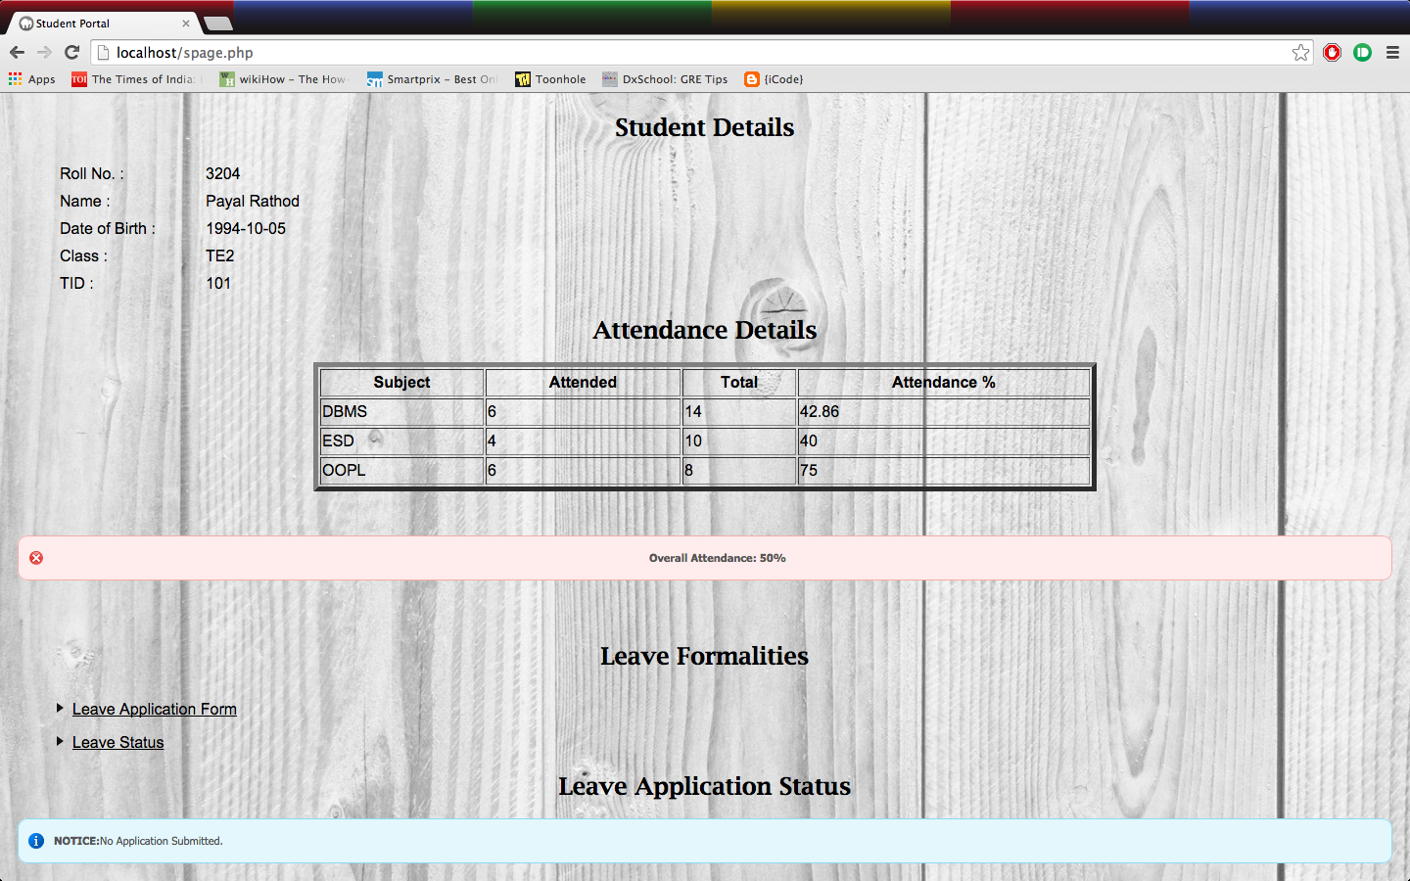
Student Page

Slide 13
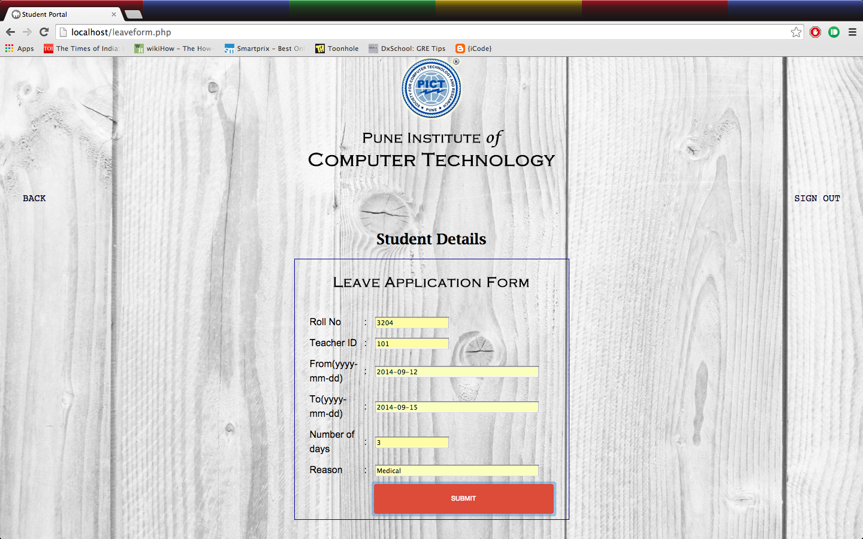
Leaveform Page

Slide 14
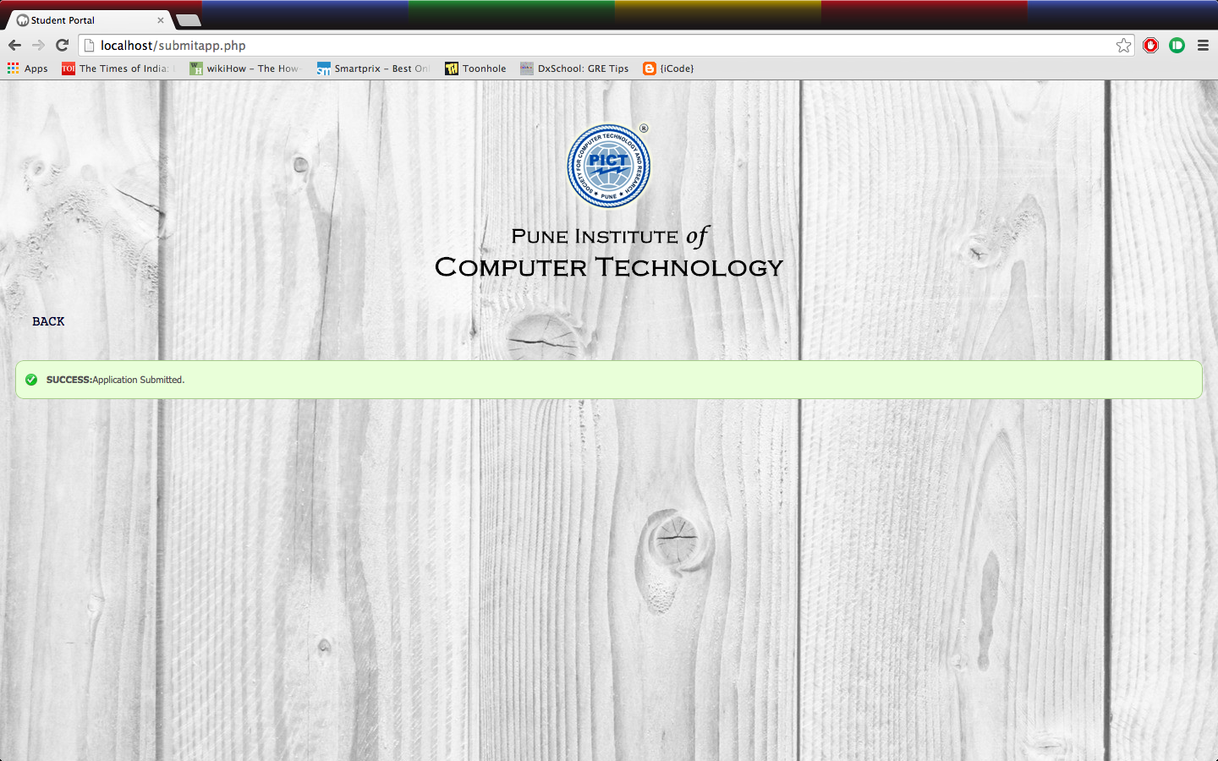
Submit Page

Slide 15
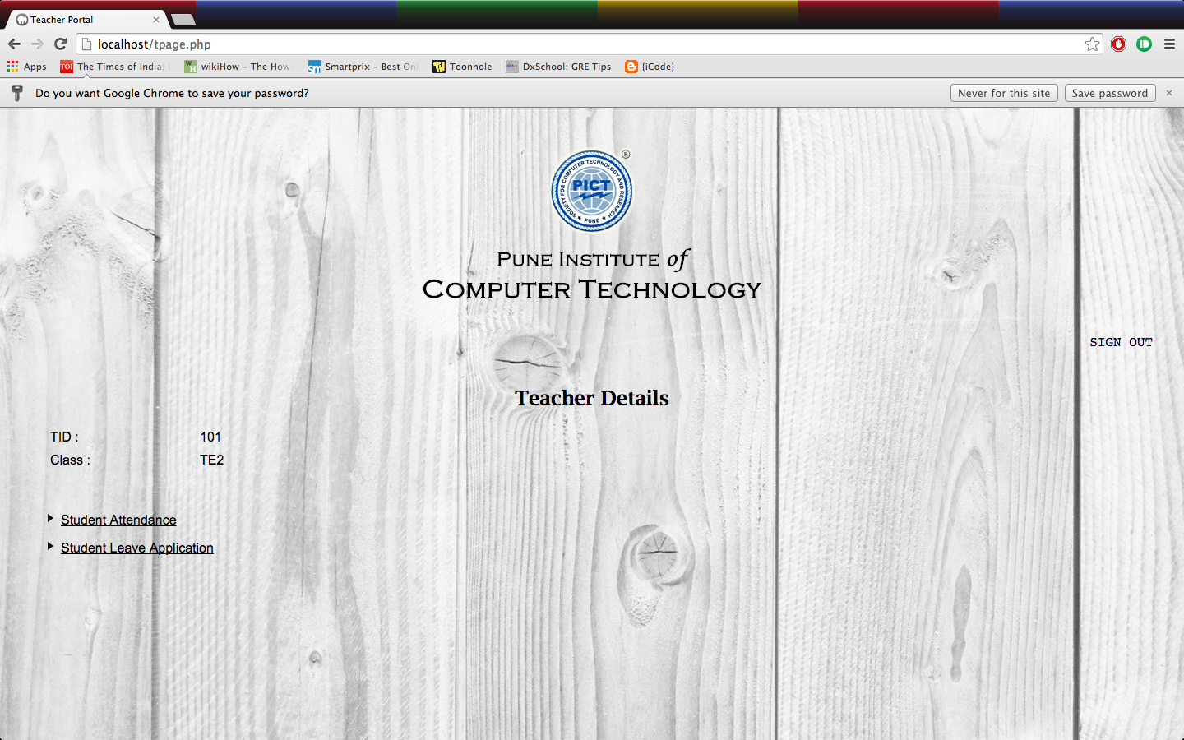
Teacher Page

Slide 16
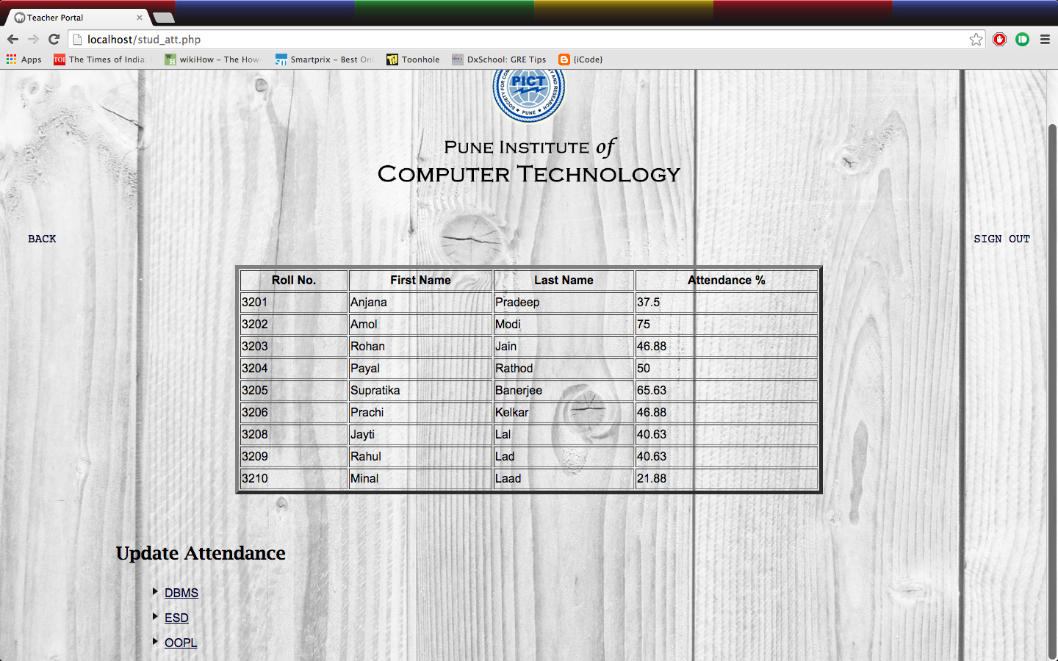
Attendance Page

Slide 17
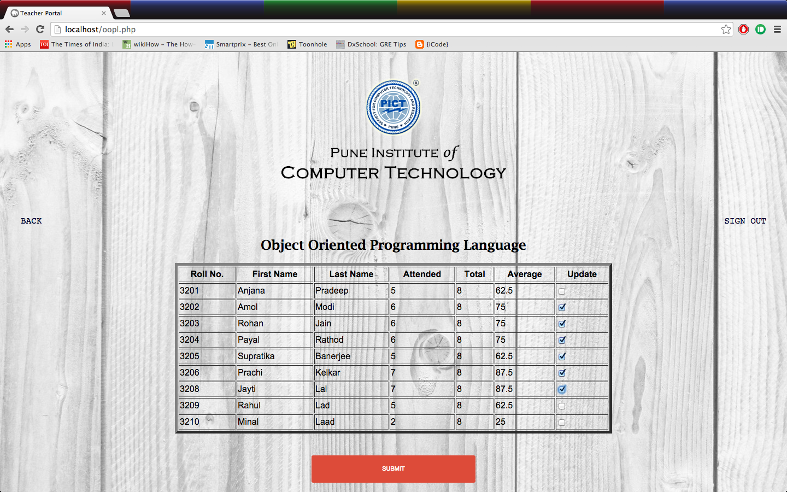
Grant Attendance Page

Slide 18
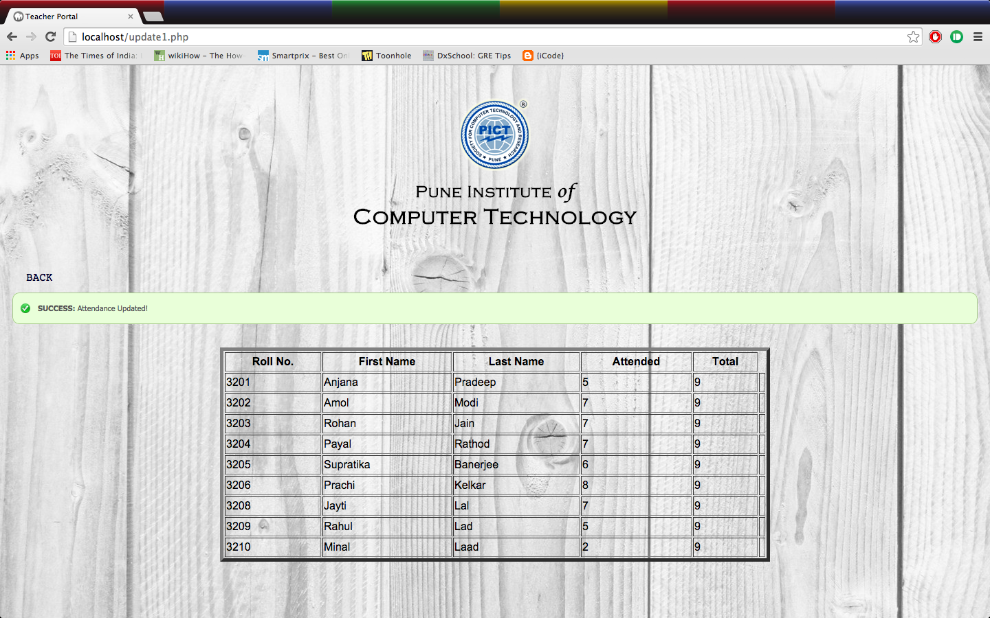
Update Attendance

Slide 19
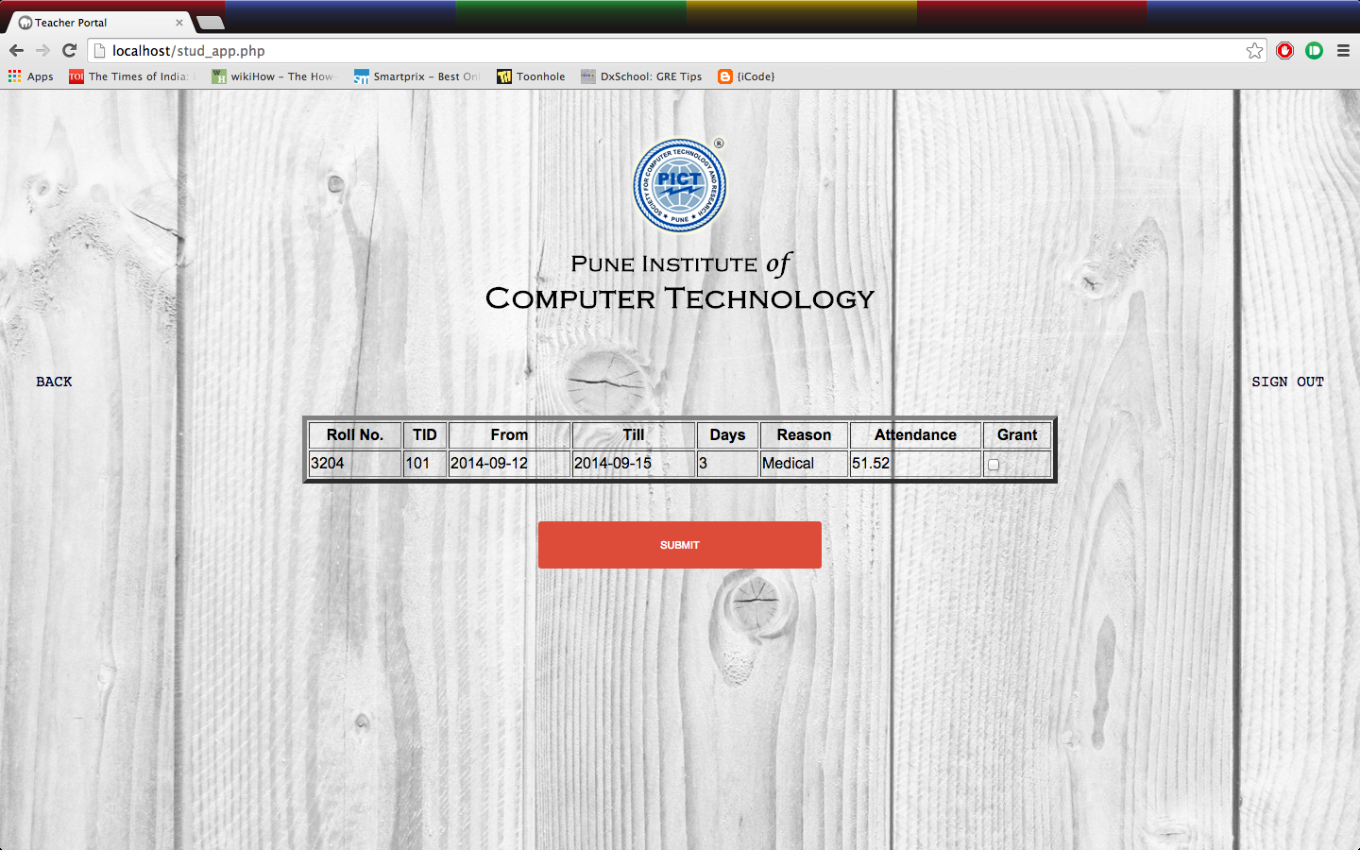
Grant Application Page

Slide 20
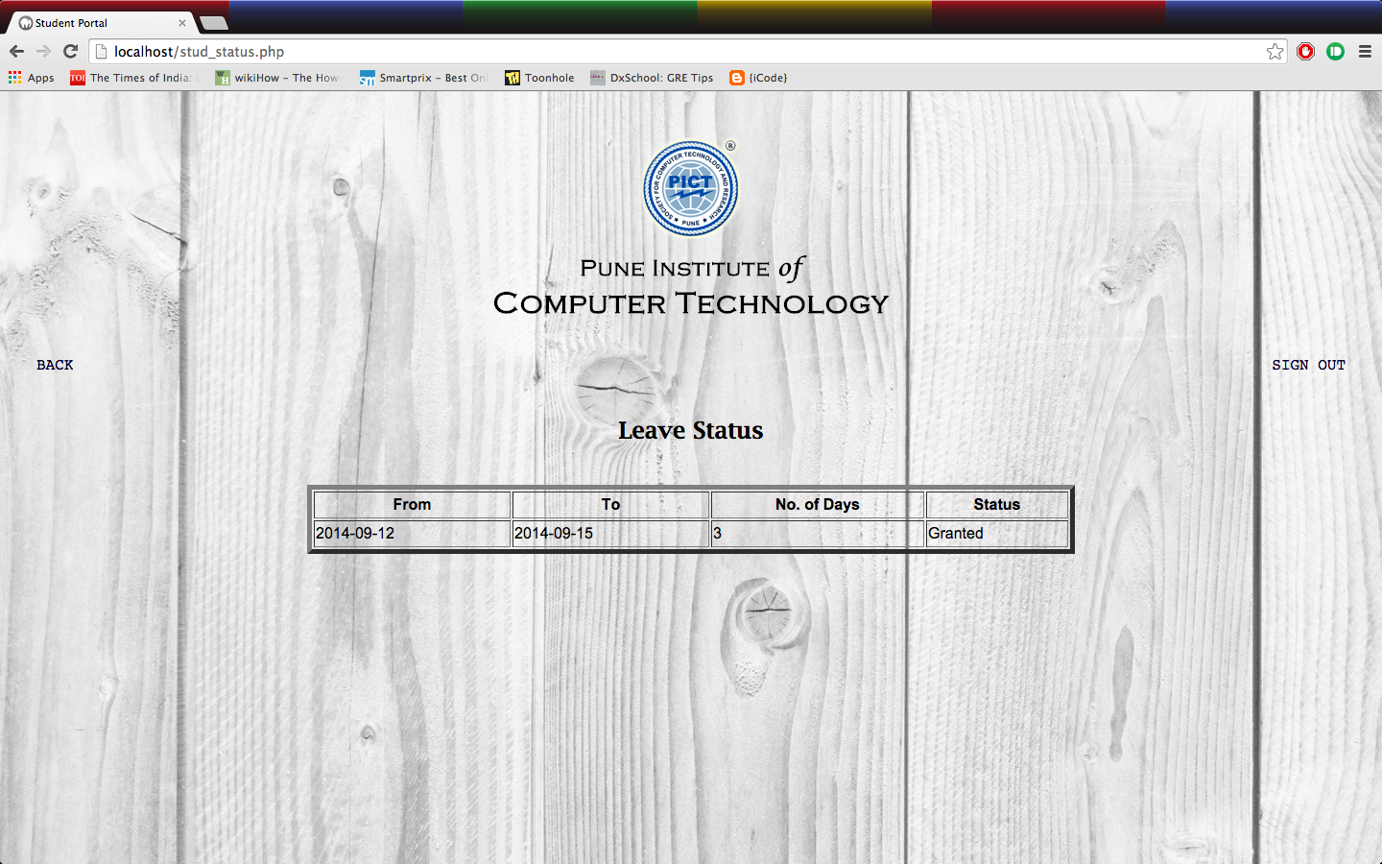
Application Status Page

Slide 21
Conclusion
Leave Management System is very useful for college to maintain the leave records of the students. This system not only maintains the attendance details of the student. it also maintains the leave applications of the staff and notices for the staff and handling of the leaves by the higher authorities .
The teachers may accept or reject the leave applications requested by the student. Thus this system maintains the excess amount of job done by college to maintain the attendance, leaves.
This Attendance Management System is using the Login mechanism by using the Username and Password. At the time of login the user needs to Punch In and at the time of logout the user needs to Punch Out.

Slide 22
Thank You

